Slide 1
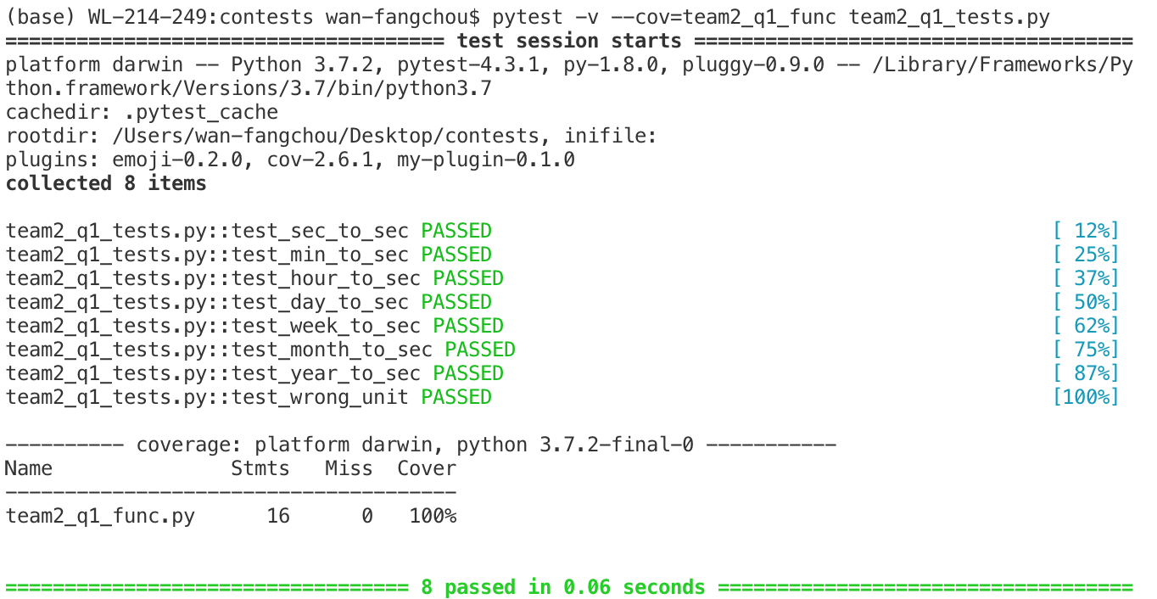
Test coverage of our tests for Q1:
The coverage for Q1 is 100%.

Slide 2
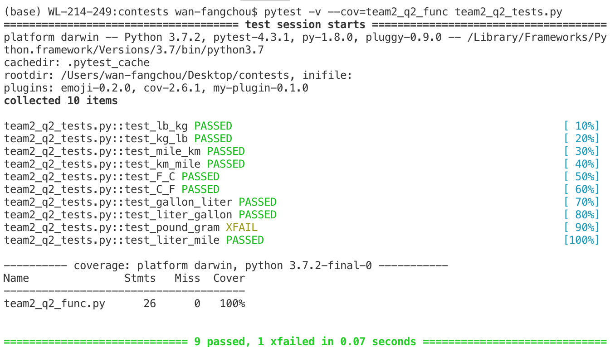
Test coverage of our tests for Q2:
The coverage for Q2 is 100%.

Slide 3
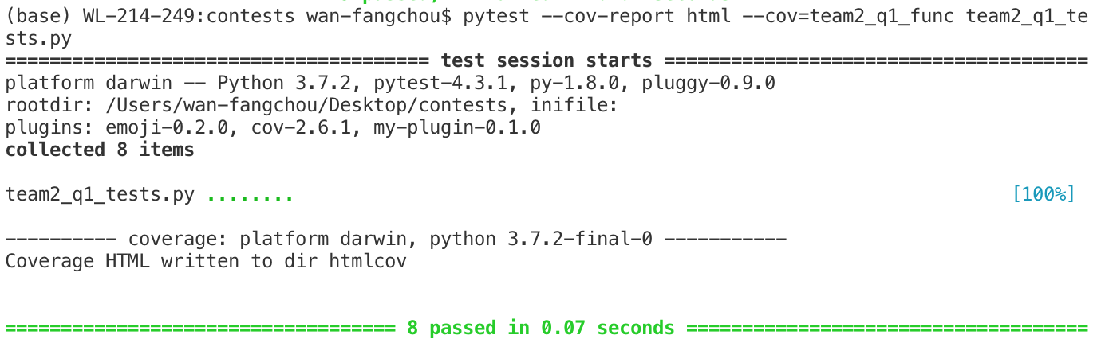
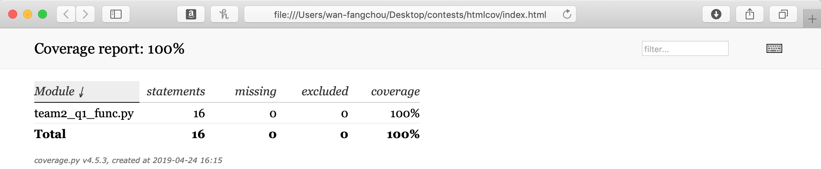
Test coverage of our tests for Q1 by generating HTML report:
file:///Users/wan-fangchou/Desktop/contests/htmlcov/index.html

Slide 4
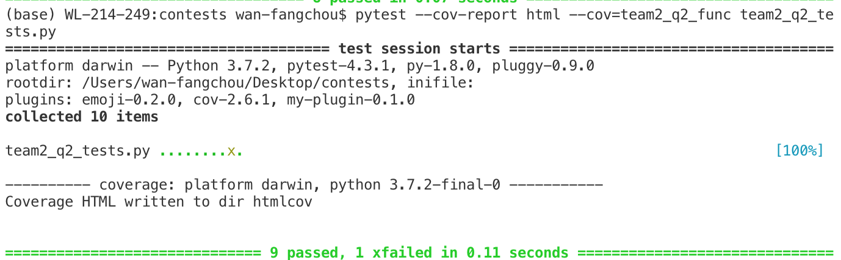
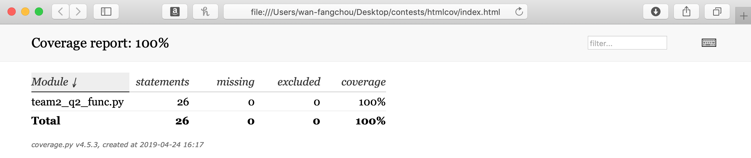
Test coverage of our tests for Q2 by generating HTML report:

Slide 5
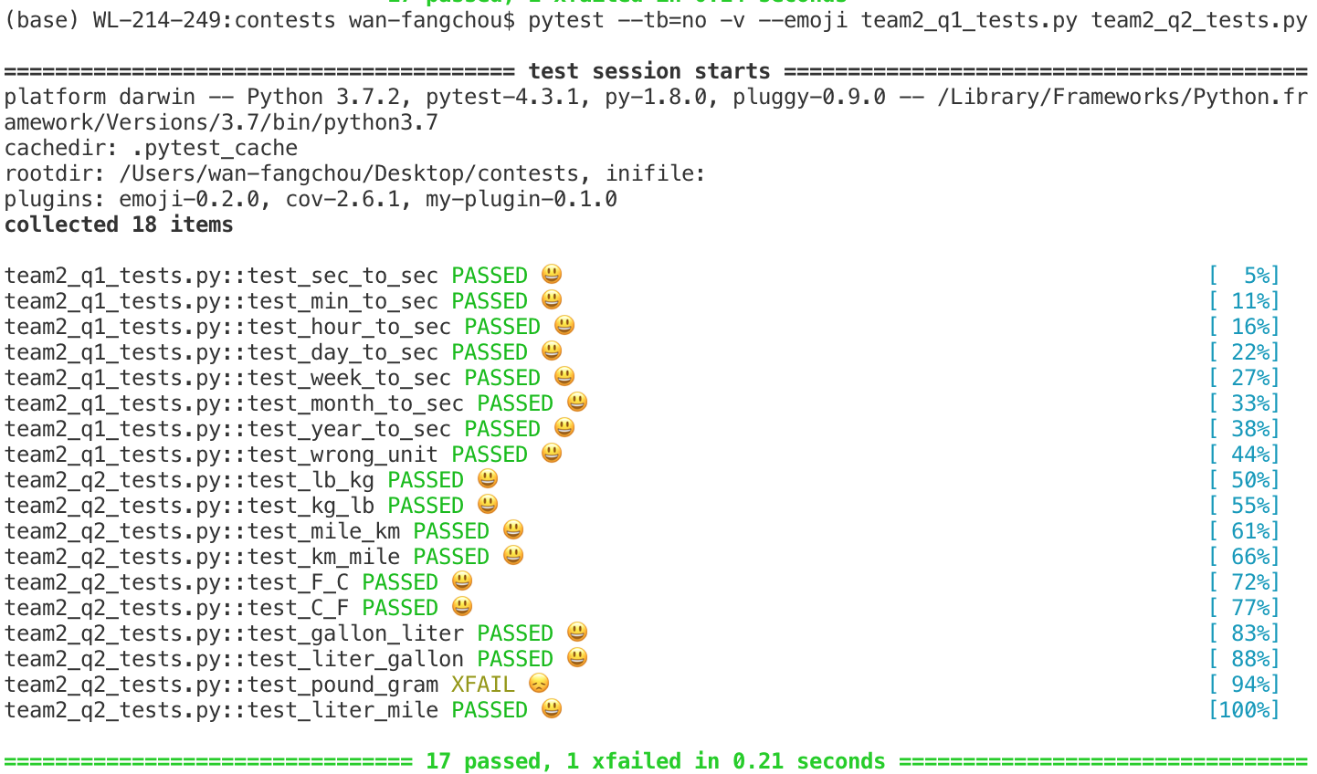
Running our tests by using pytest -emoji:

